Slide 1
Estimation Theory
Minimum Mean Square Estimation (MMSE)
Maximal Likelihood Estimation (MLE)
Bayes’ Estimation

Slide 2
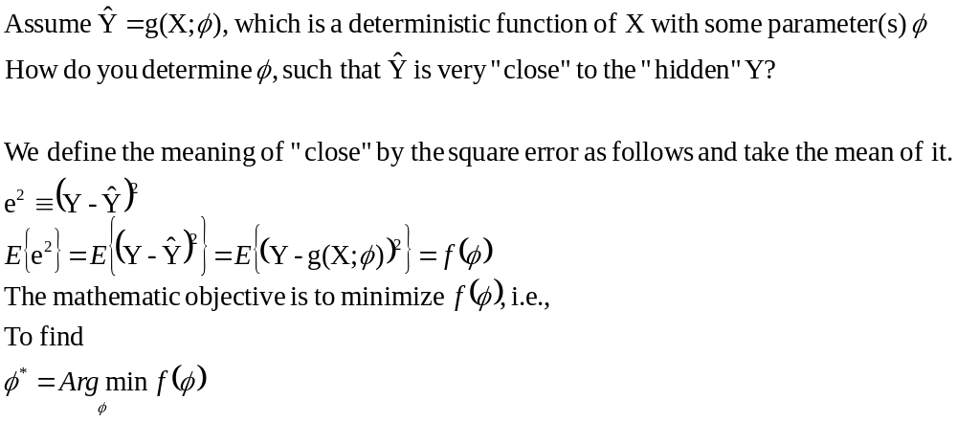
MMSE
Given random variable X as an observation, and random variable Y be “hidden” and to be estimated.

Slide 3
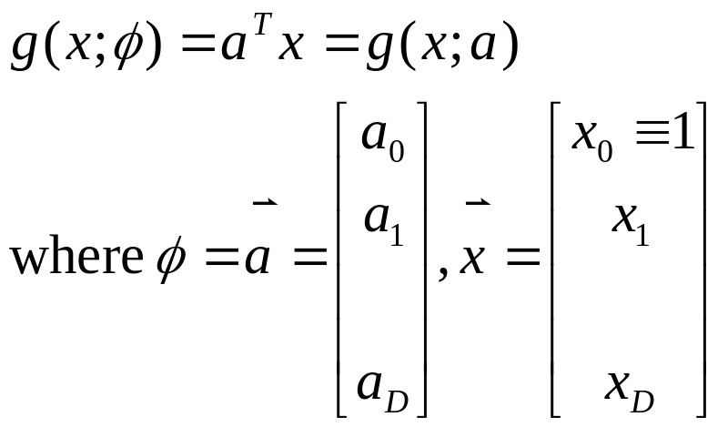
The deterministic function g(.) may fall into 2 categories
  Linear
    g(x;φ) = a . x + b = g(x; a,b)
  Non-linear
In general,

Slide 4
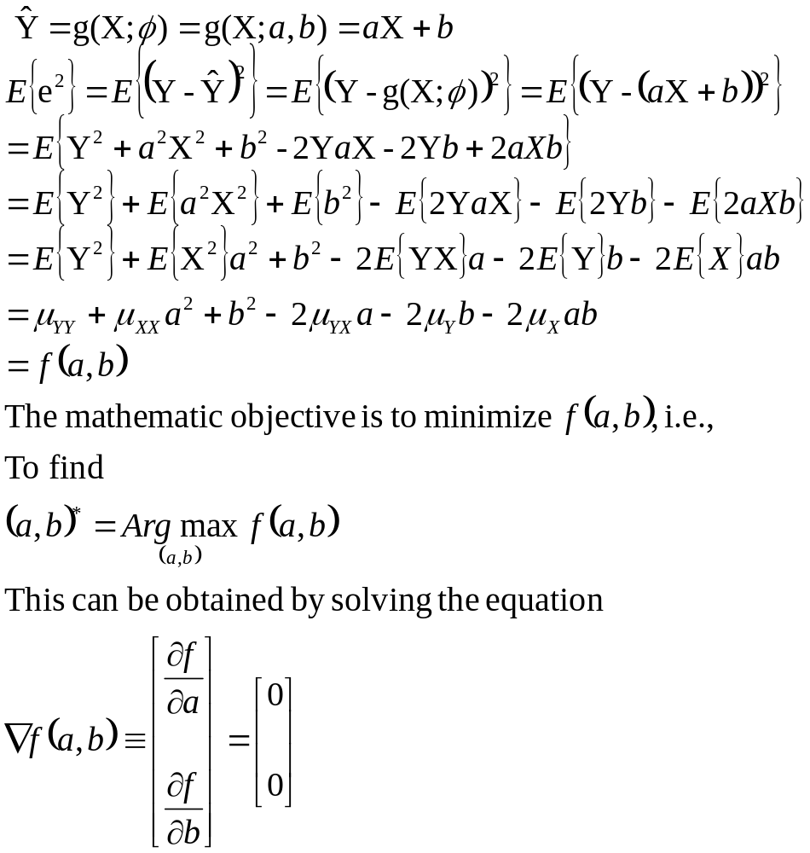
The solution to MMSE for linear estimation function

Slide 5
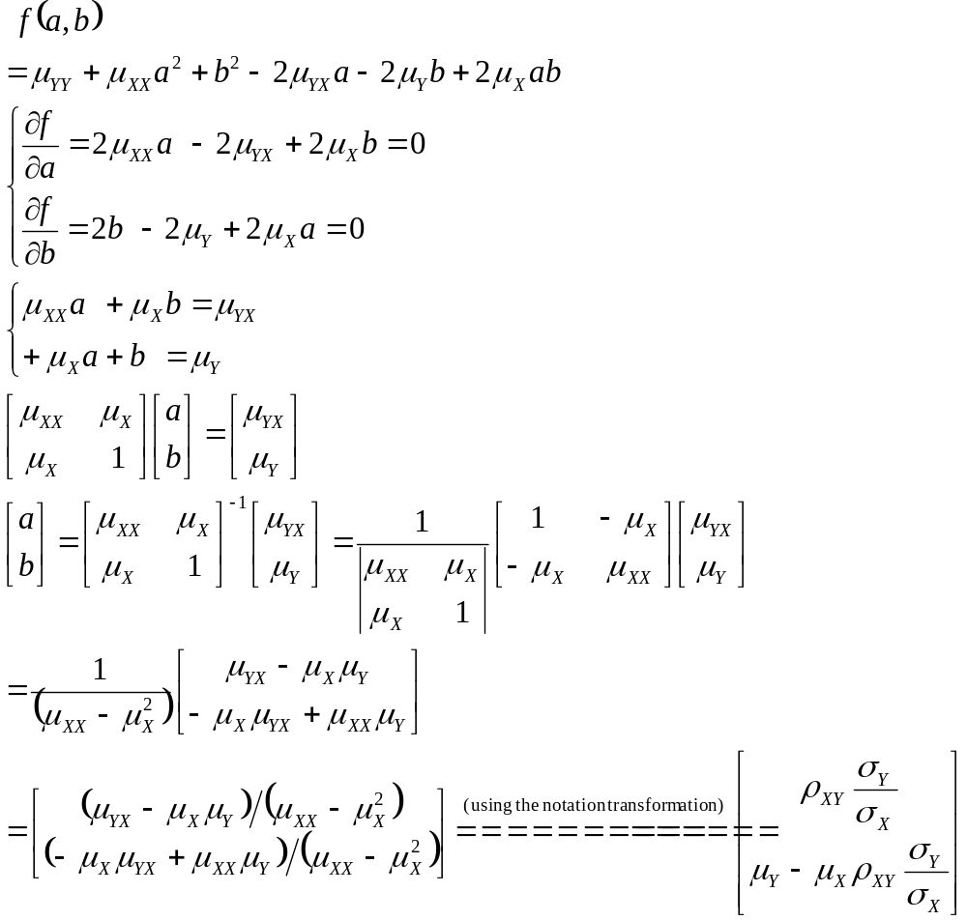

Slide 6
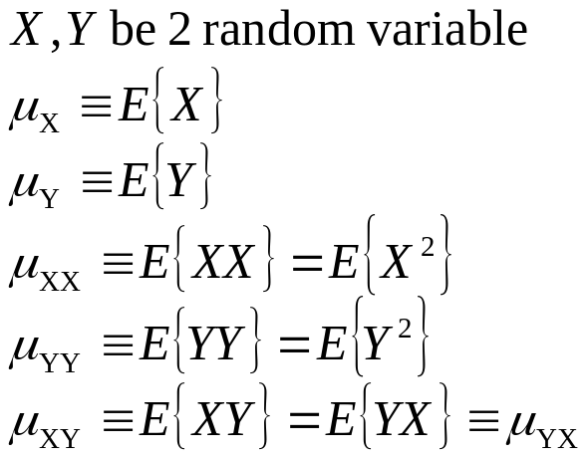
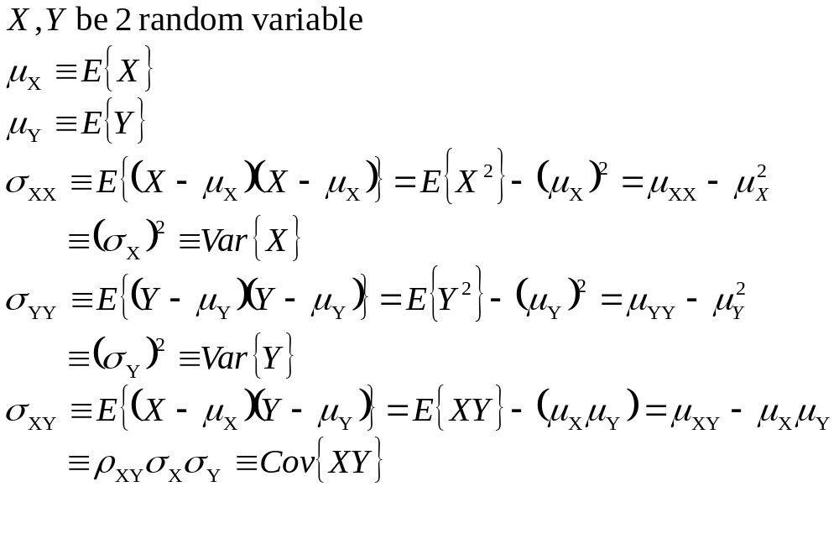
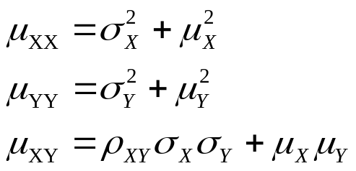
Review of notation for Expectation of random variables X, Y

Slide 7
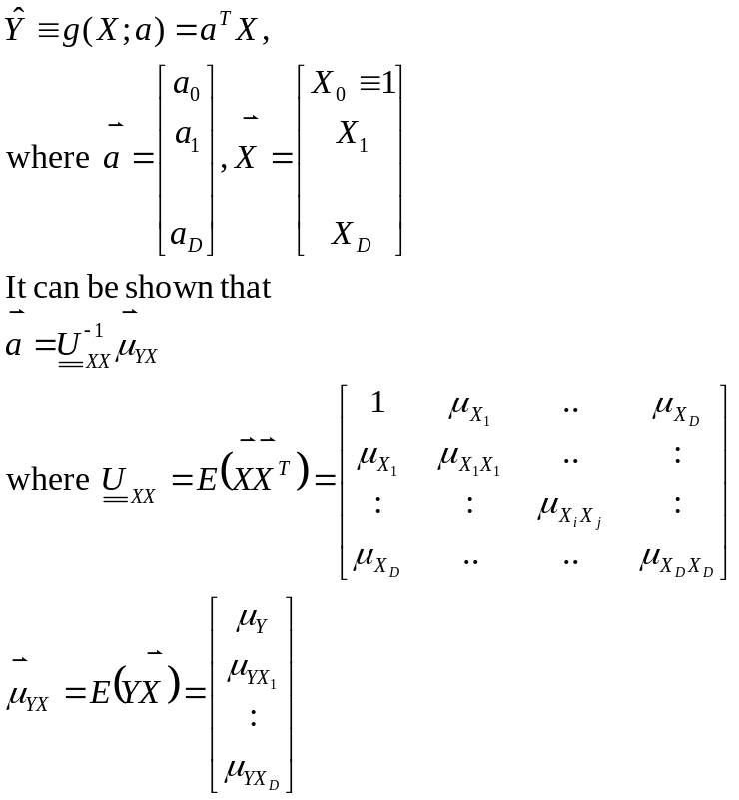
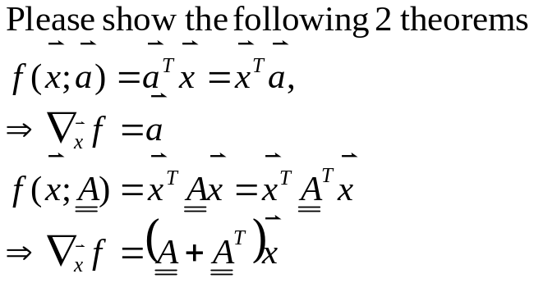
In general, when we can observe not only X, but also the other i.i.d random variables, denoted them (including X) all by X₁,X₂,X₃,….,X_{D}, then the MMS (Linear) Estimator becomes
To prove the left,
you should show the following first,
You can show that when D=1, a₁=a, a₀=b,
The above solution reduces to that in the previous page.

Slide 8
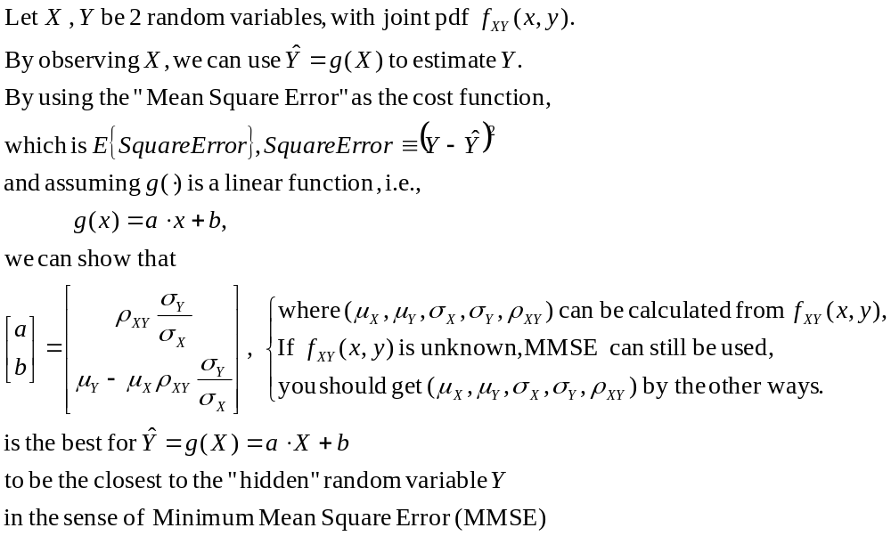
Summary of MMSE for linear function

Slide 9
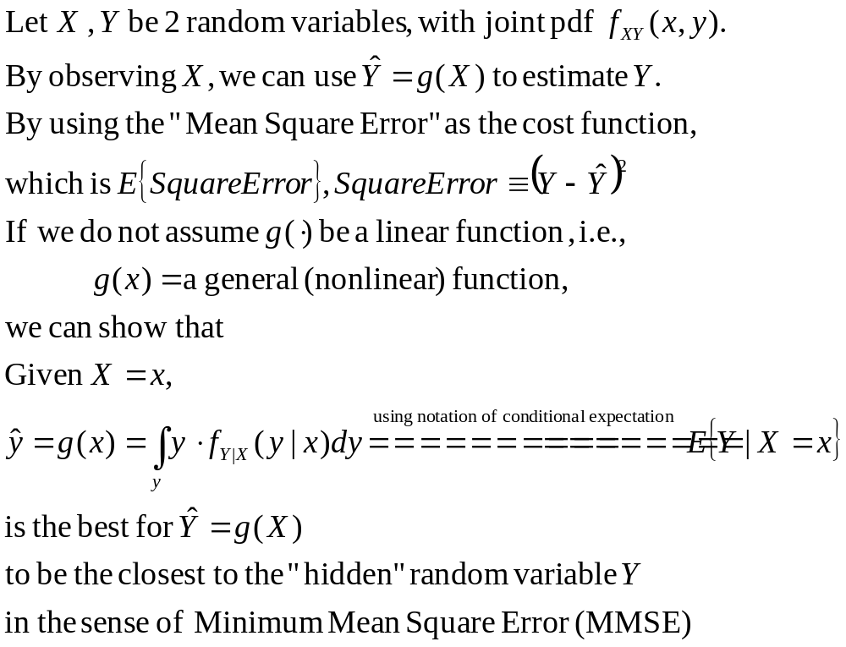

MMSE for non-linear function

Slide 10
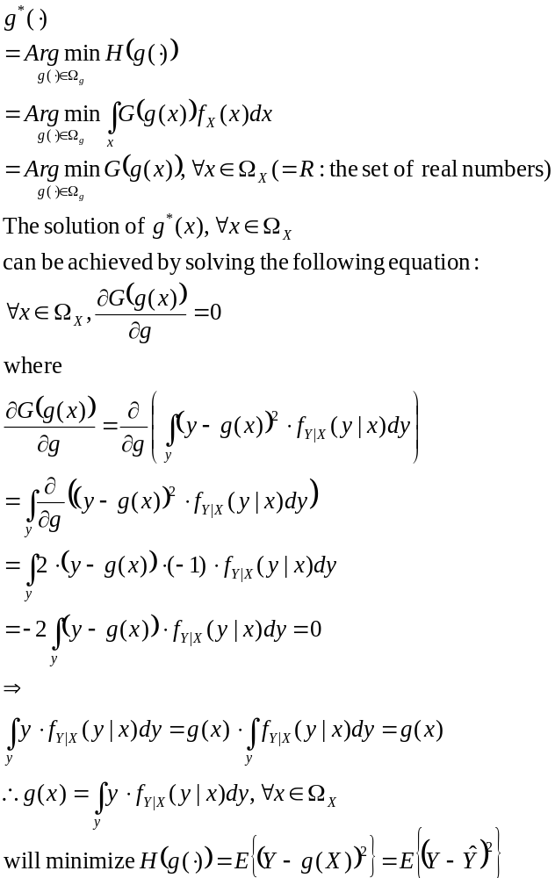
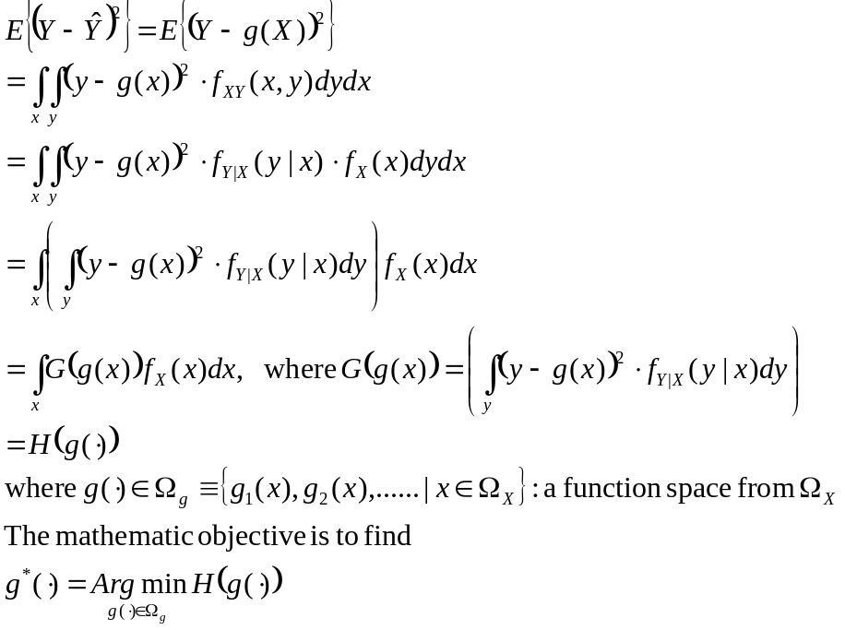
Proof of MMSE for general (non-linear) function

Slide 11
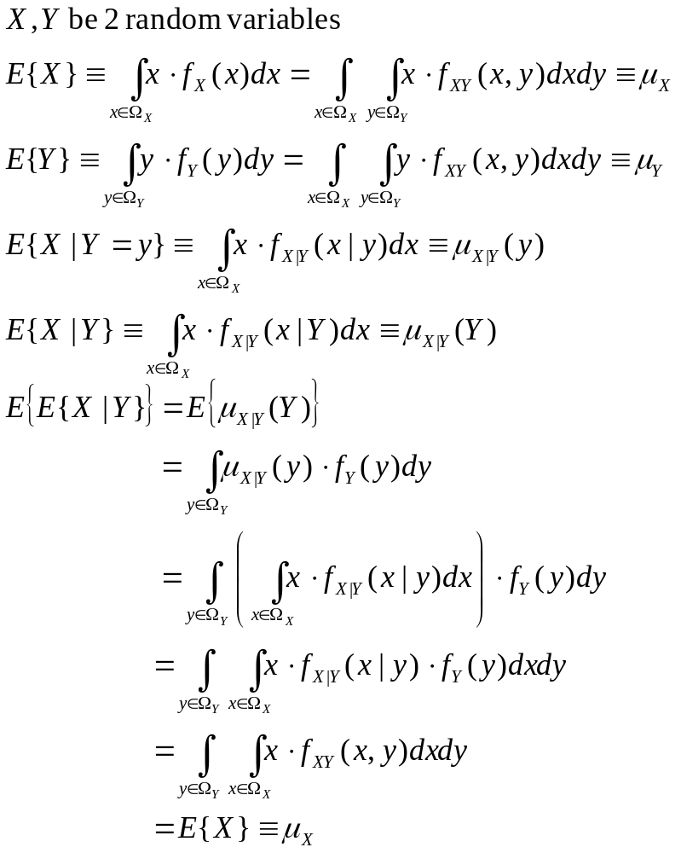
Notations for conditional expectation
… a deterministic constant
… a deterministic constant
… a deterministic function of y
… a deterministic function of Y, is itself a random variable
… a deterministic constant

Slide 12
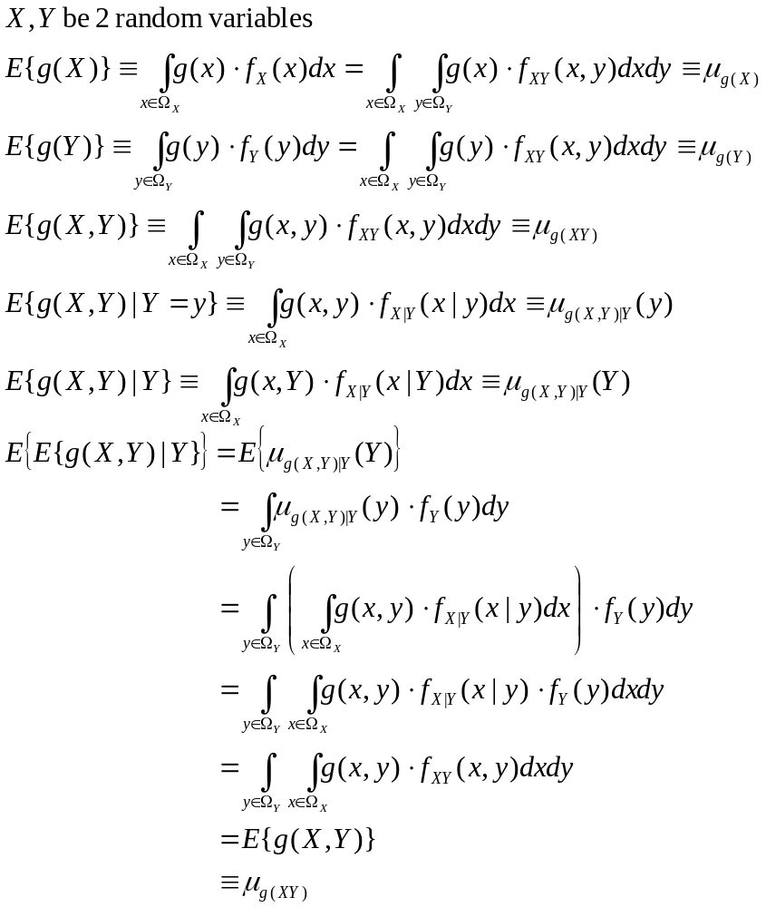

Slide 13
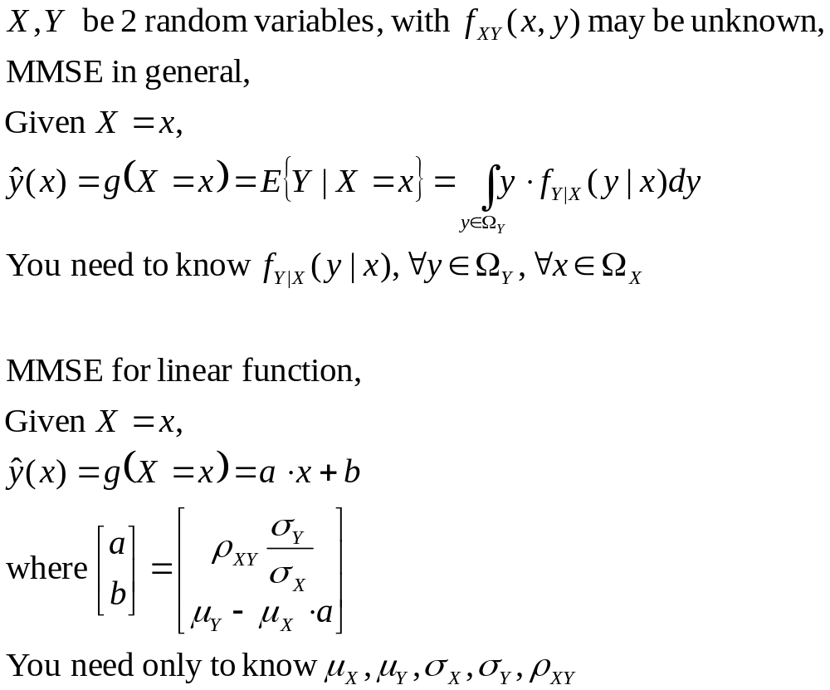
Comparison of MMSE in general and MMSE for linear function

Slide 14
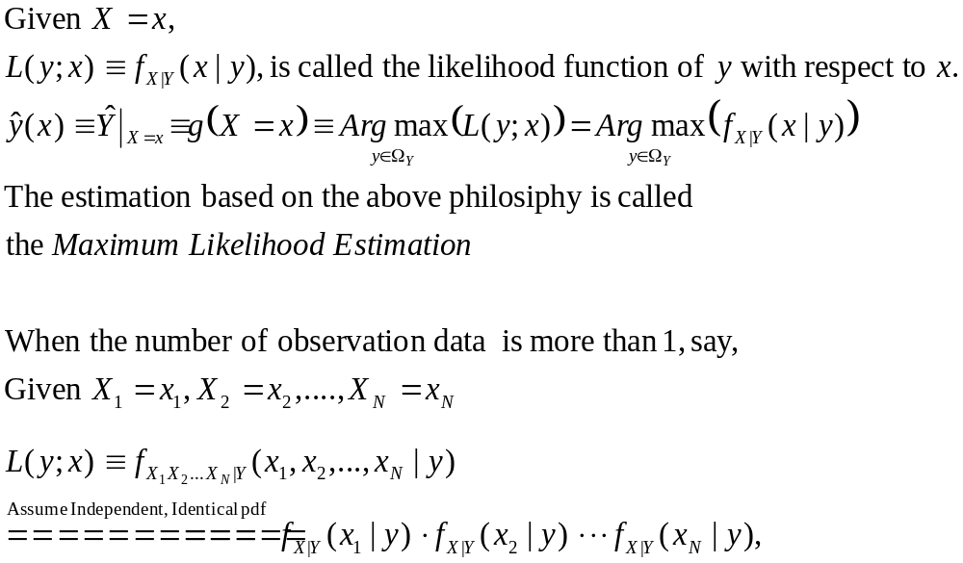
Maximal Likelihood Estimation (MLE)
Given random variable X as an observation, and random variable Y be “hidden” and to be estimated.

Slide 15
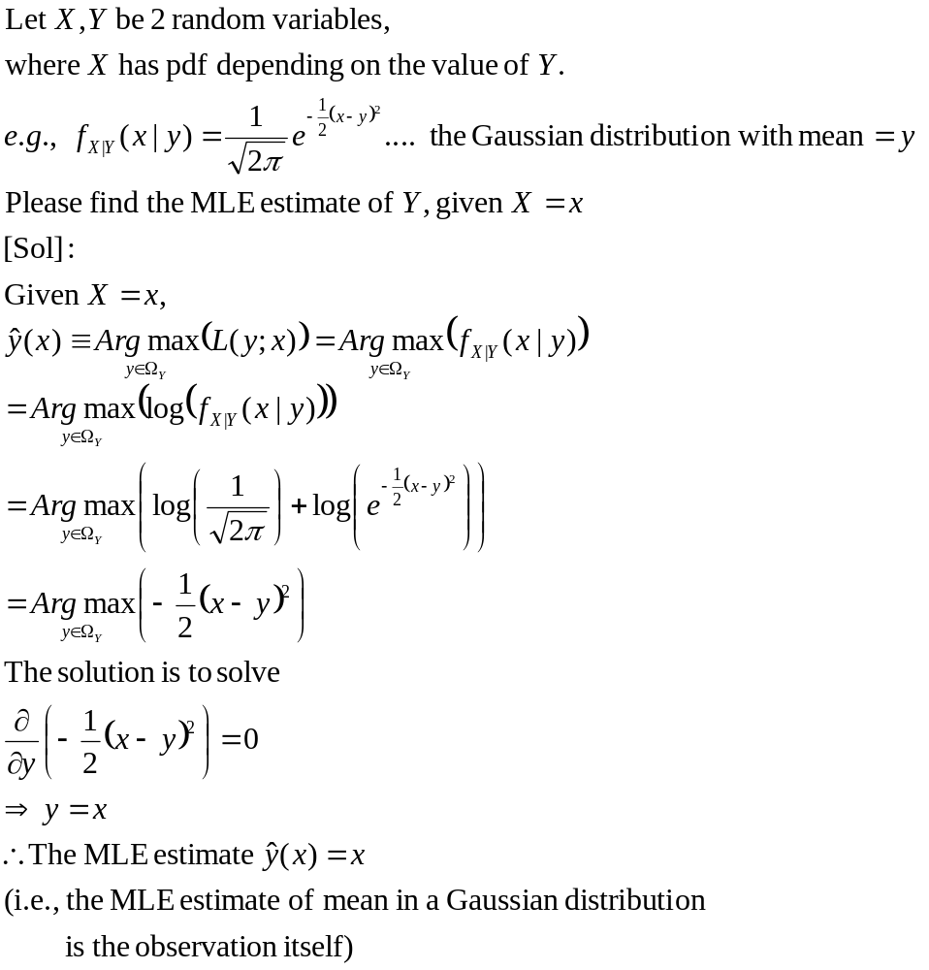
Example 1

Slide 16
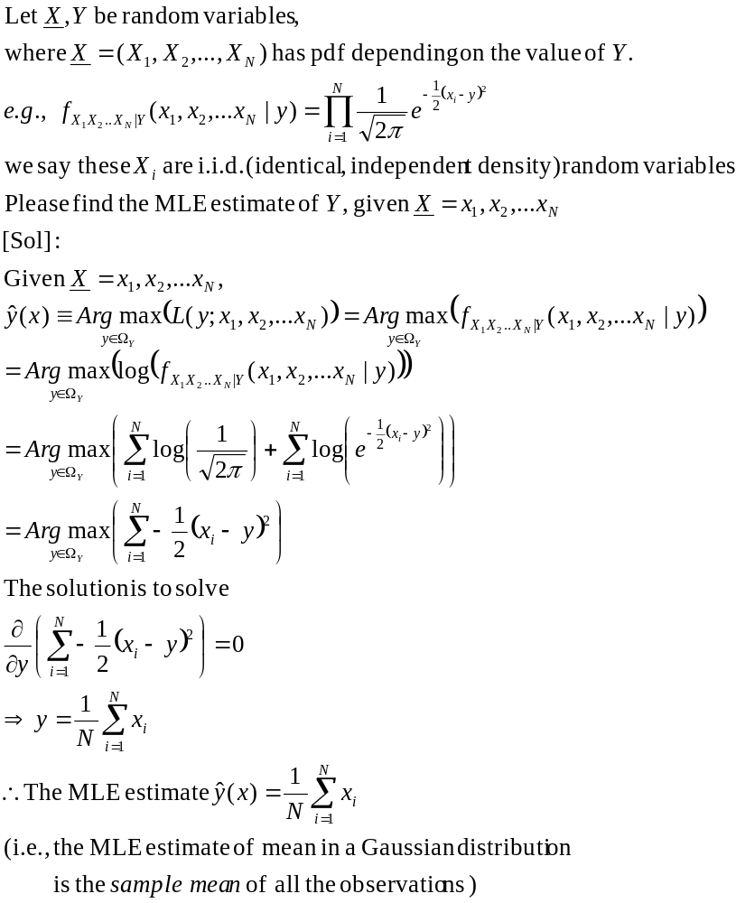
Example 2:

Slide 17
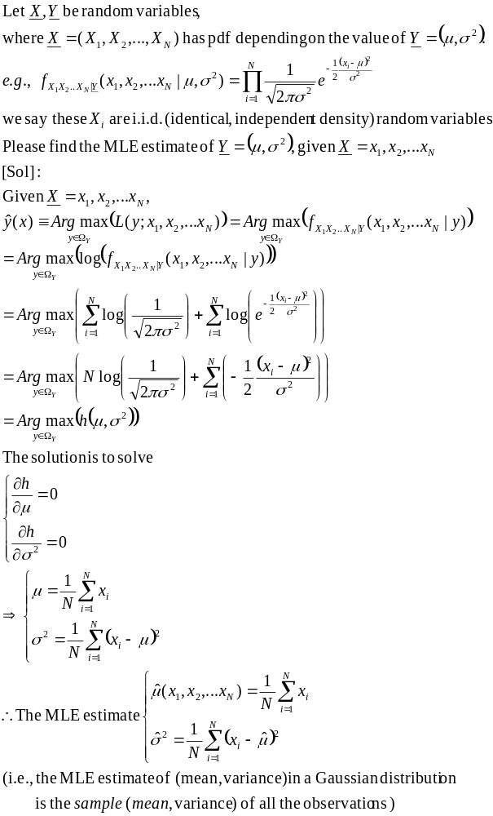
Example 3

Slide 18
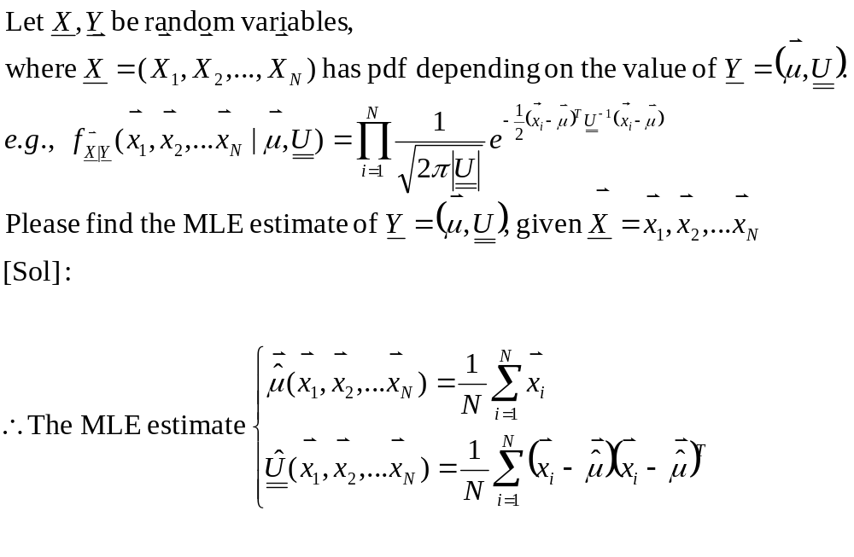
Examples 4:

